Slide 1
INSPECTRONICS 2.0
Getting Started with OpenCV
Speakers: Coordinator:
Jatin Madineni Lakshman VS
Alok N

Slide 2
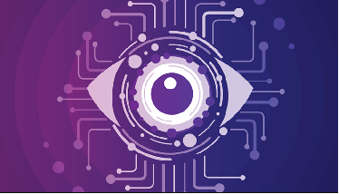
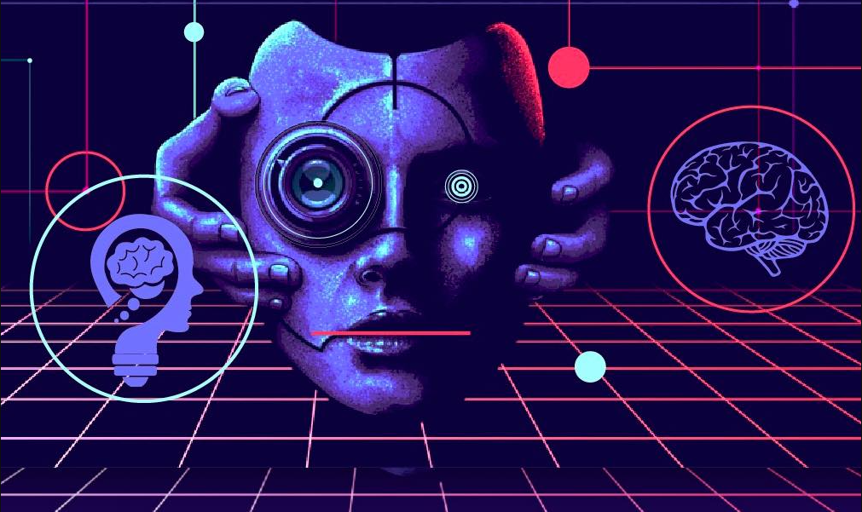
What is Computer Vision?
Computer vision is a field of artificial intelligence (AI) that enables computers and systems to derive meaningful information from digital images, videos and other visual inputs .

Slide 3
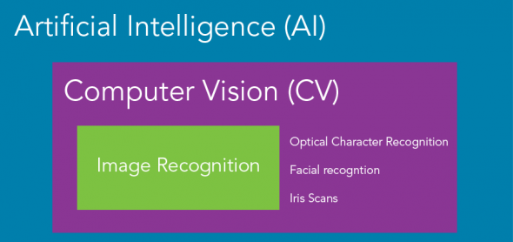
If AI enables computer to think, computer vision enables them to see, observe and understand.

Slide 4
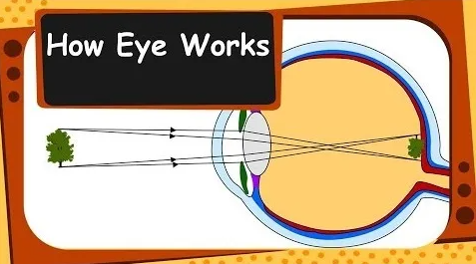
How humans see and perceive stuff?
Light moves through lens system and falls on tiny cells that work as sensors and send the image to brain, where it tells objects apart, how far they are etc.

Slide 5
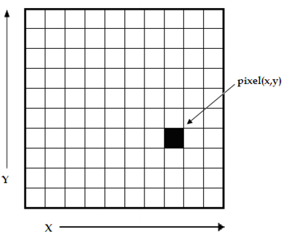
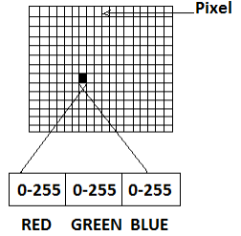
How computers see and perceive stuff?
A computer sees an image as 0s and 1s. When we take a digital image, it is stored as a combination of pixels. Each pixel contains a different number of channels. If it is a grayscale image, it has only one channel, whereas if it is a coloured image, it contains three channels: red, green and blue.

Slide 6

Difference between black&white and grayscale

Slide 7
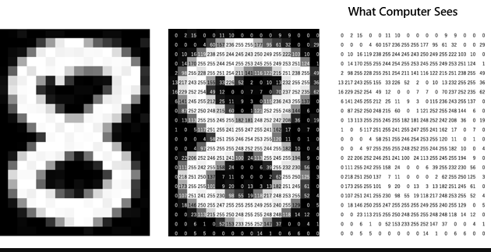

Slide 8




Popular Tools that help in Visualizing Computer Vision

Slide 9
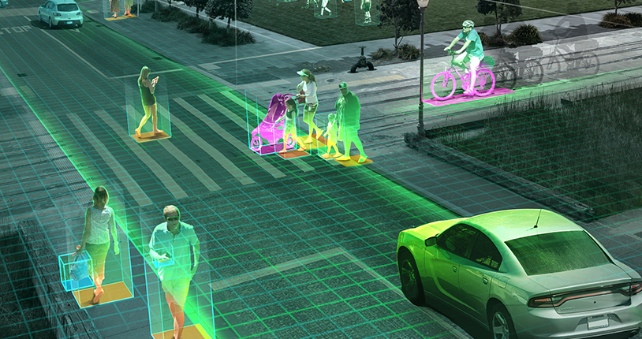
What is OpenCV and why is it so popular?
OpenCV is a huge open-source library for computer vision, machine learning,image processing and video analysis aimed at working in real-time scenarios such as CCTV cameras, self driving cars etc.

Slide 10





Features of OpenCV
Open Source
Fast Speed
Easy to integrate
Ease of coding
Fast prototyping

Slide 11
Applications of Computer Vision and OpenCV
Self driving cars
Cctv cameras
Face detection, recognition
Medical image analysis
Movies
Social distancing
Video/Image search and retrieval
Robotics

Slide 12
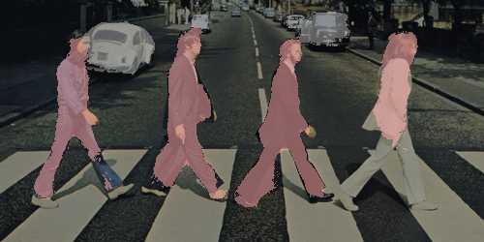
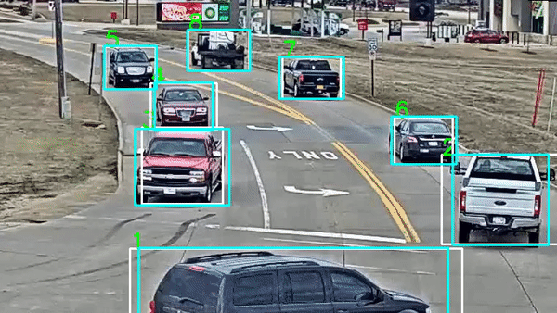
Instance Segmentation
Object Detection and Tracking

Slide 13
Some famous projects that use OpenCV are
Face ID from Apple
Tesla’s Self Driving Computer
Robotics - Hanson, Boston Dynamics
Virtual Painting App
Smart attendance system
Computational photography
Face-swapping

Slide 14

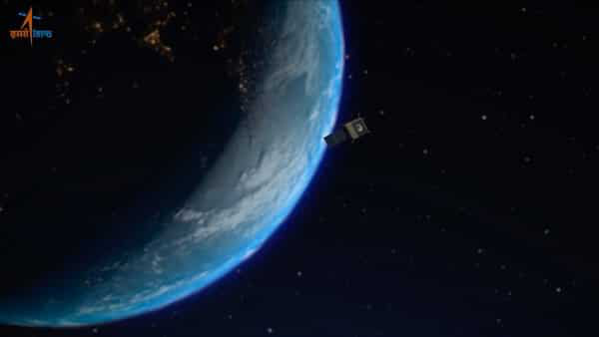

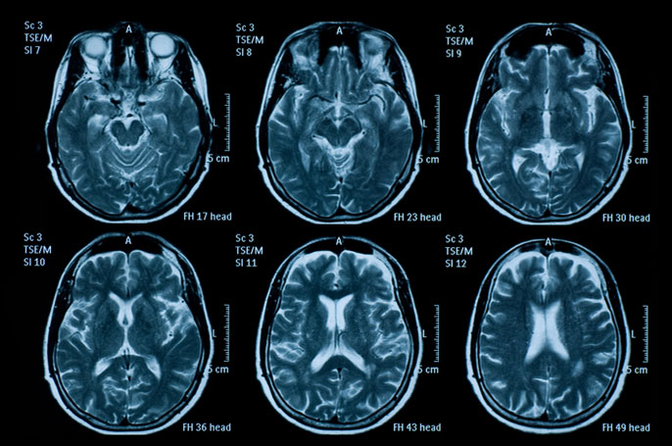
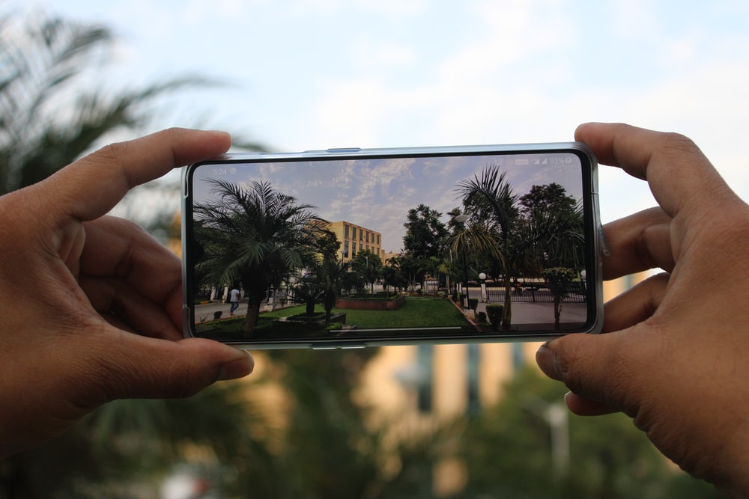

Images
Notes:
Thank you Jatin! I hope you guys got a great understanding of what Computer Vision is…
Now let’s dive deep in. What are we gonna process, or try to understand using programs today?
Images! Now what are images?
Images can be simply defined as a visual representation of something. It can be DSLR, Mobile Phone, Digital Art, satellite images from up top, and even medical scans deep inside ourselves.
All these images contain some sort of a data. It may be art which has a deep meaning inside, some structure, some knowledge, it can be anything! And when it comes to data, we use computers to process it fast! That’s why we do image processing.

Slide 15
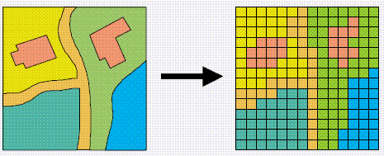
Rasters and Vectors
Notes:
When you zoom into this particular image given here, you can see pixels! For those who don’t know pixels, a pixel is a square that contains the smallest form of representation of that image.
So an image, is formed by a lottttt of pixels. You know you’ve seen 720p 1080p in Youtube, Can anyone say the no. of pixels of one frame in the youtube video of 1080p? Or 720p? 1080p will be 1920x1080 = 20,72,360 pixels in each frame. The size of ONE pixel? 0.26 mm
But however big the image is, if you zoom that much you can see those pixels! But what if i say there are images where no matter how much you zoom, you can’t see the paths?

Slide 16

Vectors
Notes:
Vectors are formed from paths, or you can say mathematical formulas! So say there’s a circle in the image, it’ll be stored as 2*pi*r with pi*r^2. So you don’t need these square pixels!

Slide 17
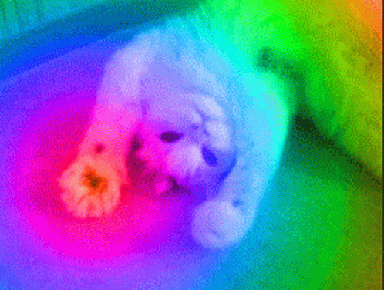
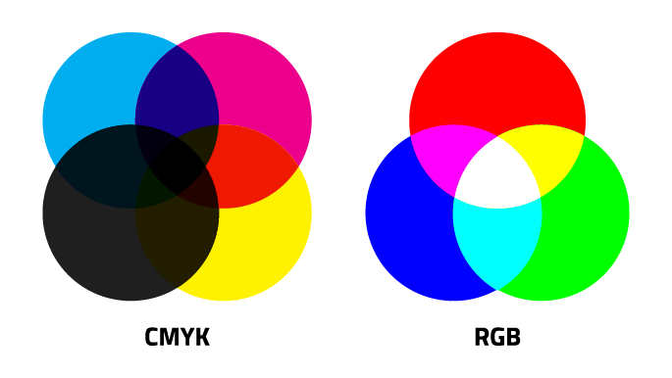
Color Schemes in Images
Notes:
All these images that we saw now were coloured! Can anybody name any sort of color schemes that you know??
Have you guys heard about RGB? CMYK? HSV?

Slide 18
Images and Arrays
Notes:
As y’all know, computers are dumb. They only know, or they can only deal with 0s and 1s at its core level. So if we give it an image, it has no idea what it is!
That’s why they see it as numbers! At the end of the day, they’re just calculators! So they deal with numbers, hence an array of numbers, or you can call a list of numbers is how they see an image.
EXAMPLE

Slide 19
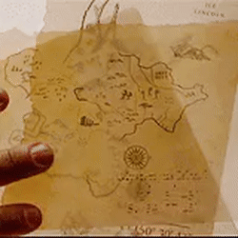

Arithmetic Operations on Images
Notes:
Can we perform arithmetic operations on images? Simple stuff like add, subtract
What do you guys think??
Journey 2: The mysterious island
EXAMPLE

Slide 20
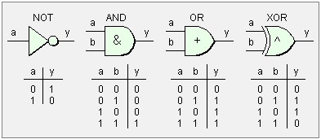
Bitwise Operations
Notes:
You might’ve seen this logic gates in your electronics courses right. Basically these gates are what are inside the computer. These are used to perform their respective operations on bits.
And these operations are NOT, AND, OR XOR.

Slide 21
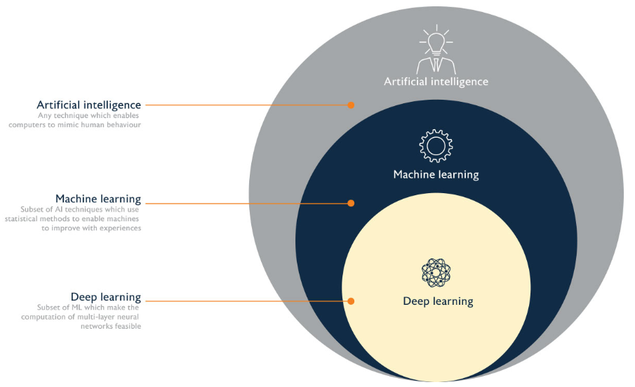
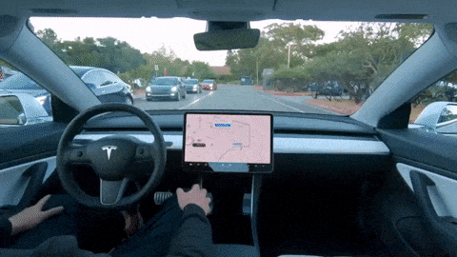
ML and Image Processing
Notes:
Using machine learning is really important when it comes to Computer Vision. All these mathematical operations will only become useful as a subpart of this.
So when it comes to image processing projects, say face detection, or object detection, or these self driving cars that you see here, requires data to learn what’s this, and then it predicts a result.
So Machine Learning, is what takes in the “processed” image and then predicts, or gives an output after “artificially thinking” you can say.
Now there’s something called Deep Learning as you can see in this image! Machine Learning is a subset of AI, and Deep Learning is a subset of ML. What deep learning is, or how its different from ML is basically that Deep Learning tries to think based on how our human brain thinks.
Our human brain contains neurons and network of neurons. So developers or AI scientists use something called as neural networks to simulate the brain, and try to perform some predictions based on that.
All this can be used in computer vision and to use incredible projects, just google more research more about computer vision, check our resources and you can be the best at OpenCV!

Slide 22
Hands On OpenCV!

Slide 23


Slide 24

Follow us on our social media handles
Kindly fill the feedback form

Slide 25
Thank you!

